Slide 1
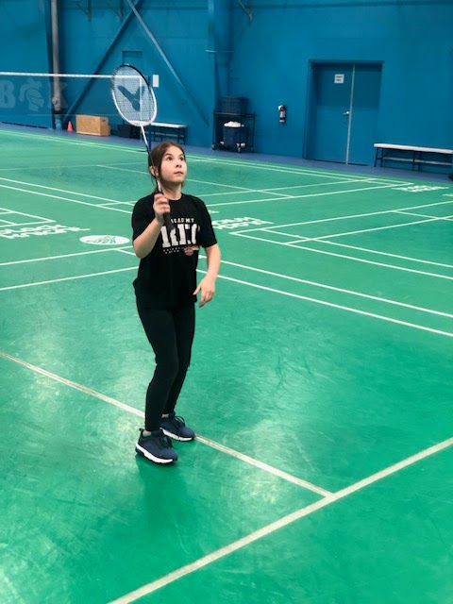
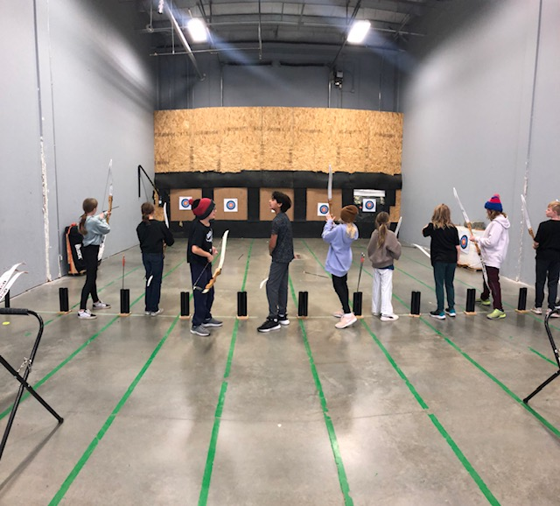
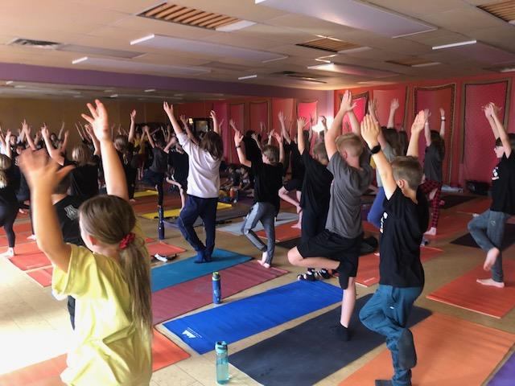
Recreation Academy
At Ronald Harvey

Slide 2

What is Rec?
The elementary Rec program is offered one afternoon or morning a week. Students participate in non-traditional physical education activities like paddling, archery, rock climbing, and ninja warrior workouts, along with more traditional sports activities.
Our Program is based on a student centered, experiential environment. Students get the chance to participate in a multitude of activities in our surrounding community weekly!

Slide 3
What type of students join the Rec Academy?
Every kid is a Rec kid!
Due to the nature of the activities we do (many of our activities are non traditional: like paddling, archery, rock climbing etc.) - most students are new to each of these activities. That means we all start off at the same starting point: wanting to try new activities in a safe and fun environment.

Slide 4
Benefits of Rec.
Get to try out new activities that you may decide to pursue on your own time.
An opportunity to get out into the community to see what it has to offer - both through indoor and outdoor experiences.
Strong focus for our students to be accountable for staying organized and ready to participate to the best of their ability each day.
Most importantly, our program builds self esteem. When kids get to try out new activities, step outside their comfort zones, they grow as individuals and can share their experiences with others.

Slide 5

HOW DO WE KEEP ORGANIZED?
REC CALENDAR AND WAIVERS
School waivers will go home every few months and need to be signed by parents/ guardians.
Along with our waivers we maintain a digital calendar on our school website. We also send home a link to printable schedules every couple months.

Slide 6
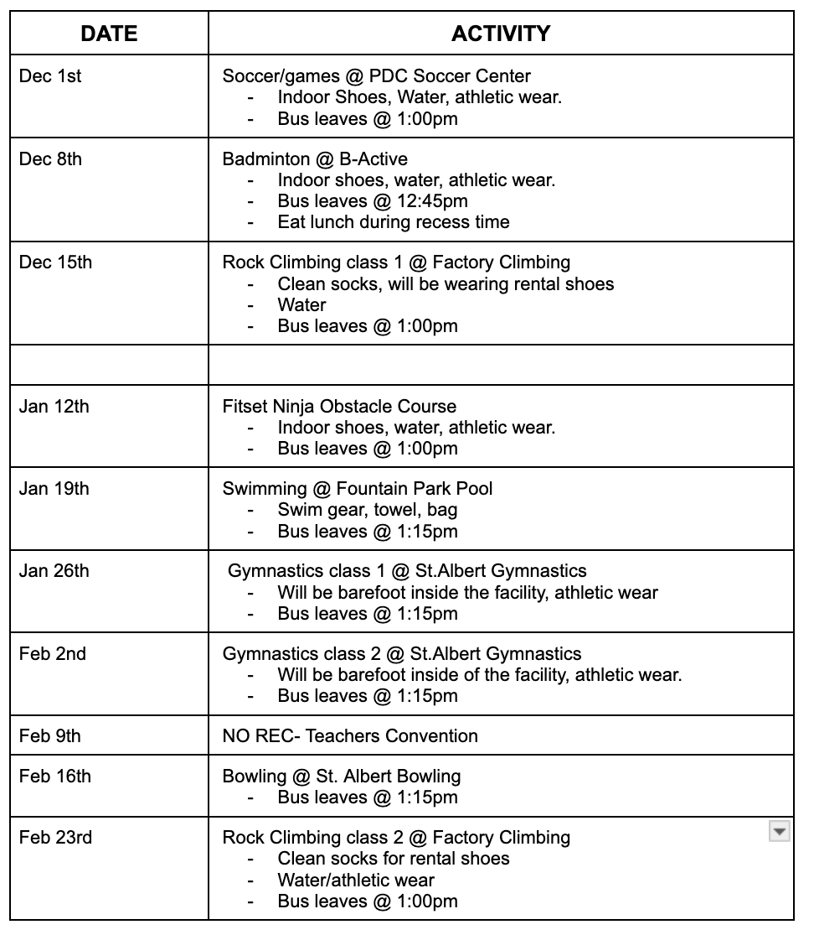
Example of a Monthly Calendar

Slide 7

Website Calendar
On the Ronald Harvey homepage Rec has it’s own calendar that can be accessed immediately through your computer or smartphone.
Click ‘Information’
Select ‘Calendar’
Select Rec Academy
After these simple instructions you will be directed to our electronic calendar that will look like this….

Slide 8


REMIND APP
We use an APP that can be easily downloaded on your smartphone or used on your computer called Remind.
This will send an instant message via text or email to anyone signed up for our class whenever a ‘remind’ is sent out.
Remind is easy to sign up for, FREE and helps us remember things daily! .

Slide 9
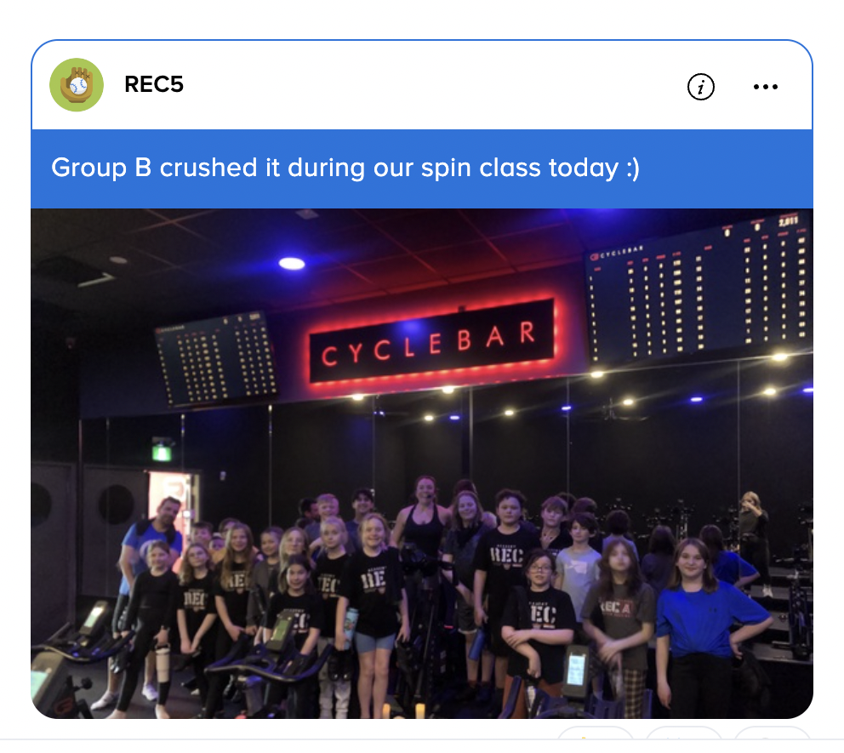
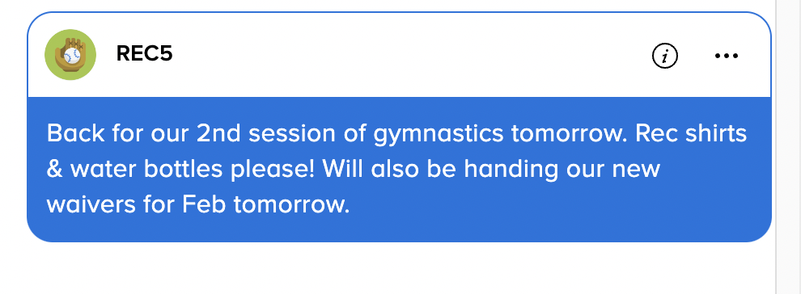
Ways we use REMIND

Slide 10

FEES
Fees are $855 for the year split over 10 months ($85.50)
Fees cover busing, admission, equipment and instructional costs
$105 non refundable clothing package deposit due once registration in the program is confirmed

Slide 11

Questions?!?!?!
If you have any further questions regarding the Ronald Harvey Recreation Academy, please contact:
Mr. Kevin Witschen- kevin.witschen@spschools.org
Mr. Kelly Hauptman - Kelly.Hauptman@spschools.org
Or phone our school at: (780)-459-5541
Phone: 780-458-8585

